Slide 1
Assessment as a Dialogue Towards Transformation in Higher Education – Can We Use This for Change?
Catherine M. Wehlburg, Ph.D.
Associate Provost, Texas Christian University
c.wehlburg@tcu.edu

Slide 2

A Time of Transitions
What is up with higher education???

Slide 3
What Can We Do?

Slide 4
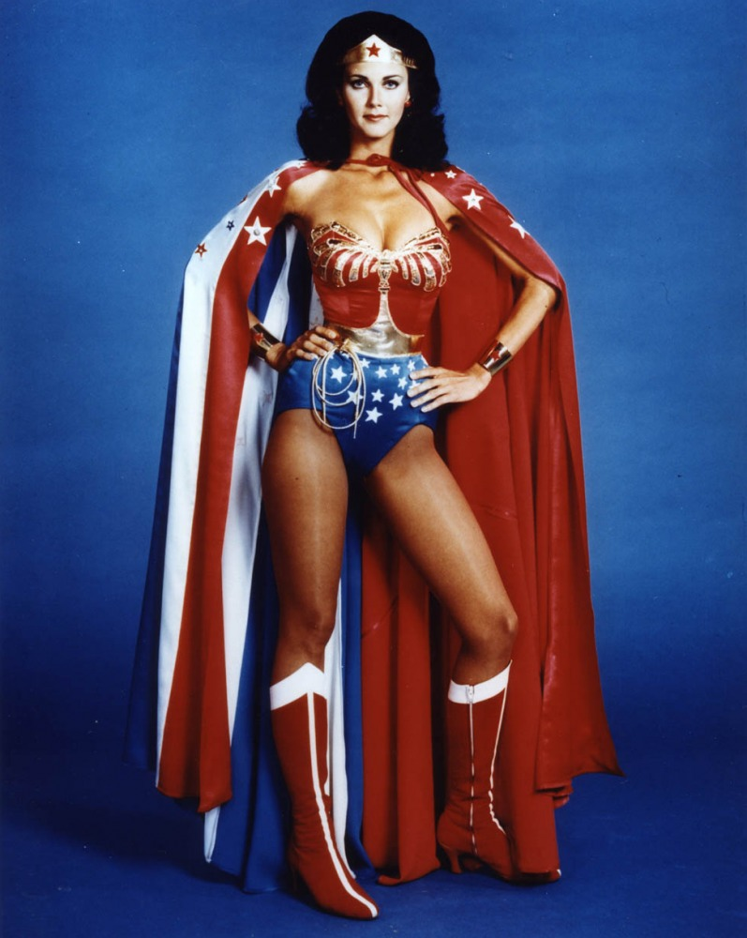

Or….

Slide 5
But How?
Assessment officers are Change Agents!
(cape not always visible)

Slide 6
What Happens Now?
Attack the instrument/measurement
  (bad survey, doesn’t measure the brilliance of my program)
Attack the methodology
  (response rate, timing, sample, “not a perfect experimental design”)
Attack the analysis
  (“the data was tortured into submission”)
Cry, Whine, Pound Fist on Table
  (why not give it a try?)
Attack the Assessment Officer
  (he/she/it isn’t qualified to evaluate me!)
  --Randy Swing (2008)

Slide 7
But…We Have Data!

Slide 8
…On What Is Important

Slide 9
And…We Know People!

Slide 10
Faculty
Why would faculty change?
  They care about student learning
  They have institutional knowledge and know what can work and what needs to change
  They have direct access to the students
  They can push for change in the administration

Slide 11
What Barriers Exist?
Faculty are busy
Faculty focus on their discipline
Faculty are rewarded for work within the department and not (usually) for work outside of their academic area
Faculty may not see assessment or institutional change as their job

Slide 12
How to Overcome
Faculty Communities
Focus on issues as they relate to student learning
Use the Faculty Senate and Committee structure to inform your decisions/process
Visit and listen
Ask for invitations to meetings
Meet the faculty where they are (literally and figuratively

Slide 13
Administrators
Why would administrators change?
  They want what is best for the institution
  They can keep (or develop) power or influence
  Maintaining accreditation is a HUGE issue
  The faculty require them to change
  They see the value in a new vision

Slide 14
What Barriers Exist?
Administrators are busy
Administrators often see their role as focusing on “THEIR” issue rather than as integrated into the overall institution
They don’t always hear the “talk” and “whispers”
They believe that they are working for the right change

Slide 15
How to Overcome
Provide data and interpret it for them
Bring solutions to existing problems
Make them look good
View their role through their eyes
Keep them informed – and ask for their feedback
Touch base informally when possible

Slide 16
Staff
Why would staff change?
  Staff care about students and their futures
  New rules, laws, or policies
  New situations or roles
  Students bring issues to them to solve
  Technology changes

Slide 17
What Barriers Exist?
Outdated practices or policies
Lack of insight across campus lines
Not clearly seeing a need for change or an existing problem
No rewards for changing

Slide 18
How to Overcome?
Know the policies – and their history
Talk with staff about issues BEFORE they become problematic (if possible)
Provide them with the data they need to make good decisions
Take on the responsibility for requesting the change (or pass on to other appropriate sources)
Thank them – a lot!

Slide 19
Students
Why would students change?
  They do!

Slide 20
So….what do we change?
  Higher Education?
  Pedagogy
  Assessment Practices?
  Accreditation Requirements?
  Federal Mandates?
  All of the Above?

Slide 21
Transformative Change
The change made is more than cosmetic or decorative – it must be meaningful
The change is based on real information that identifies an issue or challenge
The change results in long-lasting improvements

Slide 22
But….HOW???
Question Everything!
Look Carefully at “Sacred Cows”
Ask the REALLY Hard Questions
Admit Errors or Missteps

Slide 23
BUT…..HOW????
Get yourself on campus-wide committees
Get yourself involved with strategic planning and implementation
Know your institutional budget – and budget managers
Speak to faculty senate, President’s councils, or any possible group to share data, plans, information, etc.
Tie assessment questions (and results) to strategic plans, institutional programs, and decision-making data points
Get involved at the state and national level, too!

Slide 24
Ask The Right Questions
Are our students meeting our mission statements? Is our Mission Statement any good?
Do faculty teach with the mission statement in mind? How do we know? What does this do for student learning?
Are our students becoming more global? More able to solve problems? Better able to think critically?
What do our constituents want to know? Why?
How do we know? What do we know?
And many, many more….

Slide 25
Because…
It’s not about assessment – it’s about learning
and it’s about
our future!

Slide 26
In a Way – It IS About Assessment…
Assessment Can:
  provide the support and backbone to higher education
  provide the map into the future
  change education by helping us to focus on what is important

Slide 27
BUT…..
Change is hard
Change takes time
Few people (especially those in higher education) enjoy it
You probably won’t be celebrated (at first)
You’ll need your sense of humor

Slide 28
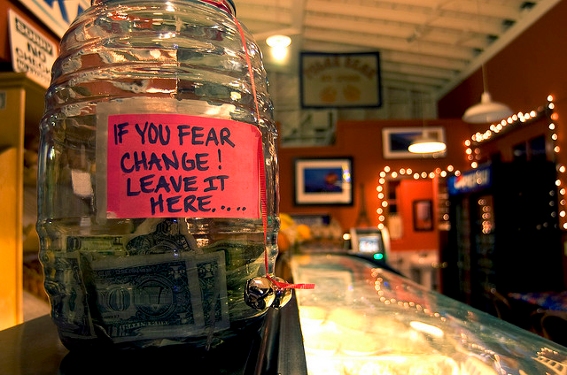

Slide 29
How Many Academics Does It Take to Change a Light Bulb ?
None. That's what research students are for.
Five: One to write the grant proposal, one to do the mathematical modelling, one to type the research paper, one to submit the paper for publishing, and one to hire a student to do the work.
One, but they get three publications out of it.

Slide 30
Or….
One Assessment
Change Agent!!!!

Slide 31
Seriously….
We need to make a difference.
We need to measure learning in ways that can be shared with others and in ways that will make a meaningful difference
Higher education needs to change – but it is a slow process
If we don’t make changes, someone else will – and we won’t like it

Slide 32
We Need to Manage Change and Conflict
Not all conflict is bad
Embrace conflict – know that it can be useful in moving forward
Learn to negotiate – build relationships

Slide 33
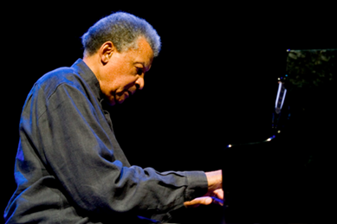
Conflict, Change, Resolution
“When time and space and change converge, we find place. We arrive in place when we resolve things. Place is peace of mind and understanding. Place is knowledge of self. Place is resolution.”
Abdullah Ibrahim,
South African pianist and composer.

Slide 34
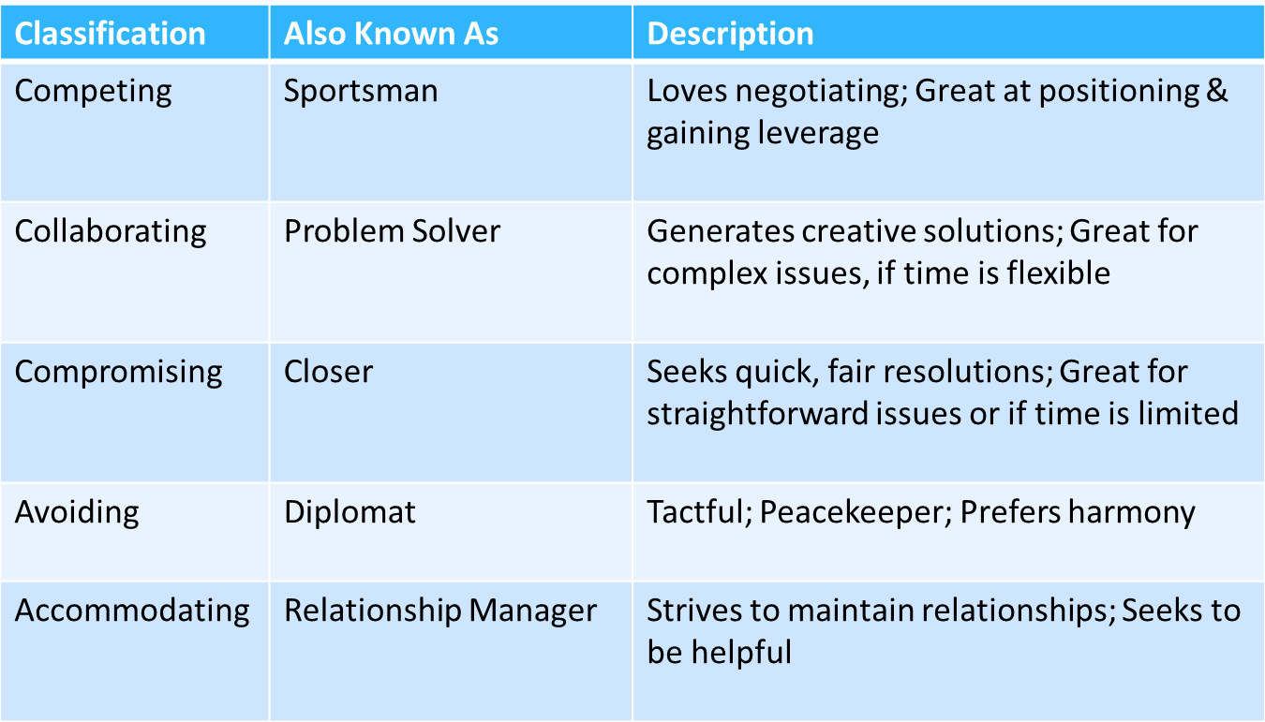
Bargaining Styles Assessment

Slide 35
What Could Happen?
Reauthorization of the Higher Education Act
State Boards of Education
Legislators (state and national) who do not have good data on student learning
Access Issues
Sustainability Issues
Class Size, Engagement, Pedagogy
Etc., Etc., Etc.,

Slide 36

Someone Has To Do It

Slide 37
It may be hard for an egg to turn into a bird: It would be a jolly sight harder for it to learn to fly while remaining an egg. We are like eggs at present. And you cannot go on indefinitely being just an ordinary, decent egg. We must be hatched or go bad.
--C.S. Lewis

Slide 38
Let’s Get Hatched!!!

