Slide 1
Overview of Assessment at TCU
Catherine Wehlburg, Ph.D.
Associate Provost
Office of Institutional Effectiveness

Slide 2
TCU’s “Assessment” Office
Office for Institutional Effectiveness
2016 Sadler Hall
Staff Include:
Director – Catherine Wehlburg
Associate Director – Chris Hightower
Graduate Assistant – Katie Krajny
Administrative Assistant – Zoanne Hogg
817-257-7156

Slide 3
Assessment AND Accreditation

Slide 4
Why Assess?
Assessment for Accountability
Assessment for Learning
Assessment for Teaching
Transformative Assessment

Slide 5
Assessment for Accountability
Assessment used for punishment
Role of regional accreditors
Used for external reasons only
“Top Down” requirement
Mechanistic and technical approach to gathering information
Assessment that is “added onto” already operating programs

Slide 6
Transformative Assessment
True purpose of assessing – enhancing student learning
Not an end in itself
Focused on student learning
Must be cyclical
Should be integrated into the regular cycle of the department/unit
Should contribute to ongoing dialogue

Slide 7
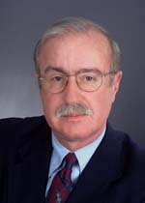
Assessment per se guarantees nothing by way of improvement; no more than a thermometer cures a fever
Ted Marchese

Slide 8
A Real Culture of Assessment
Those doing the assessment must create it
Must be based on an agreed upon and important mission statement
Trust concerning how assessment data will be used must be established
Assessment should be seen as a continuous and ongoing process
May become “messy”
Must result in enhanced learning

Slide 9
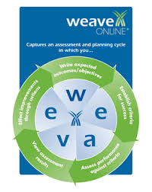
WEAVE

Slide 10
Upcoming Workshops
November 13 – 3:00 – 4:30
Creating Meaningful Student Learning Outcomes – How can we make this worth the time and effort it can take? How can we use this to improve student learning?
Location - RJH 113
January 29th – 3:00 – 4:30
Measuring Learning that Works – What ways can we better measure learning both for improvement and for the assessment reports (the accountability side)?
Location – TBA
April 8th – 3:00 – 4:30
Using Findings to Make Action Plans – How can we use our data to make curricular decisions that benefit teaching and learning? What can we do to improve and enhance what we do?
Location – TBA

Slide 11
Questions? Comments?

