Slide 1
GET IT DONE 2020
Assessment Map

Slide 2
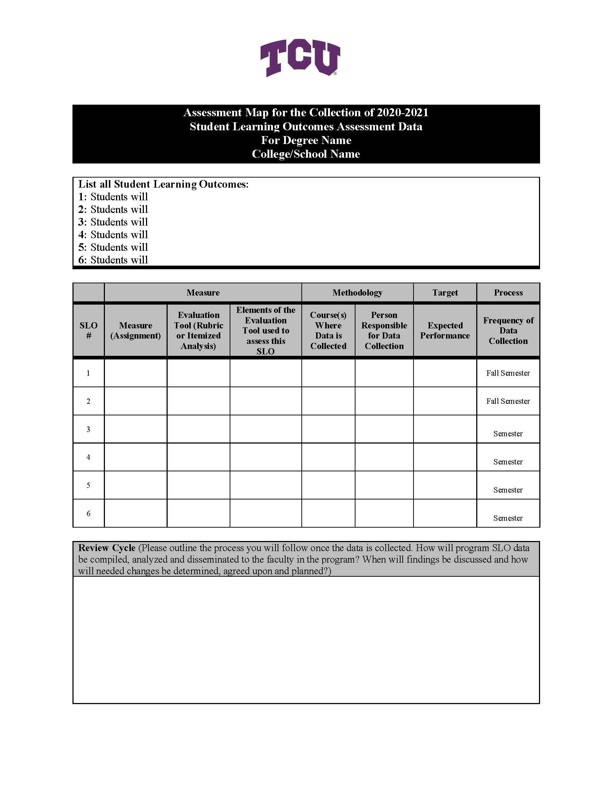
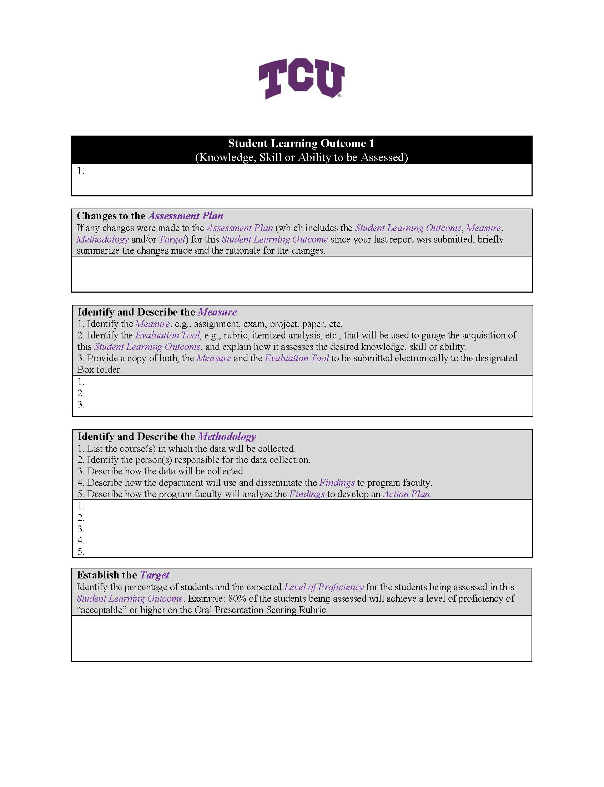

Slide 3
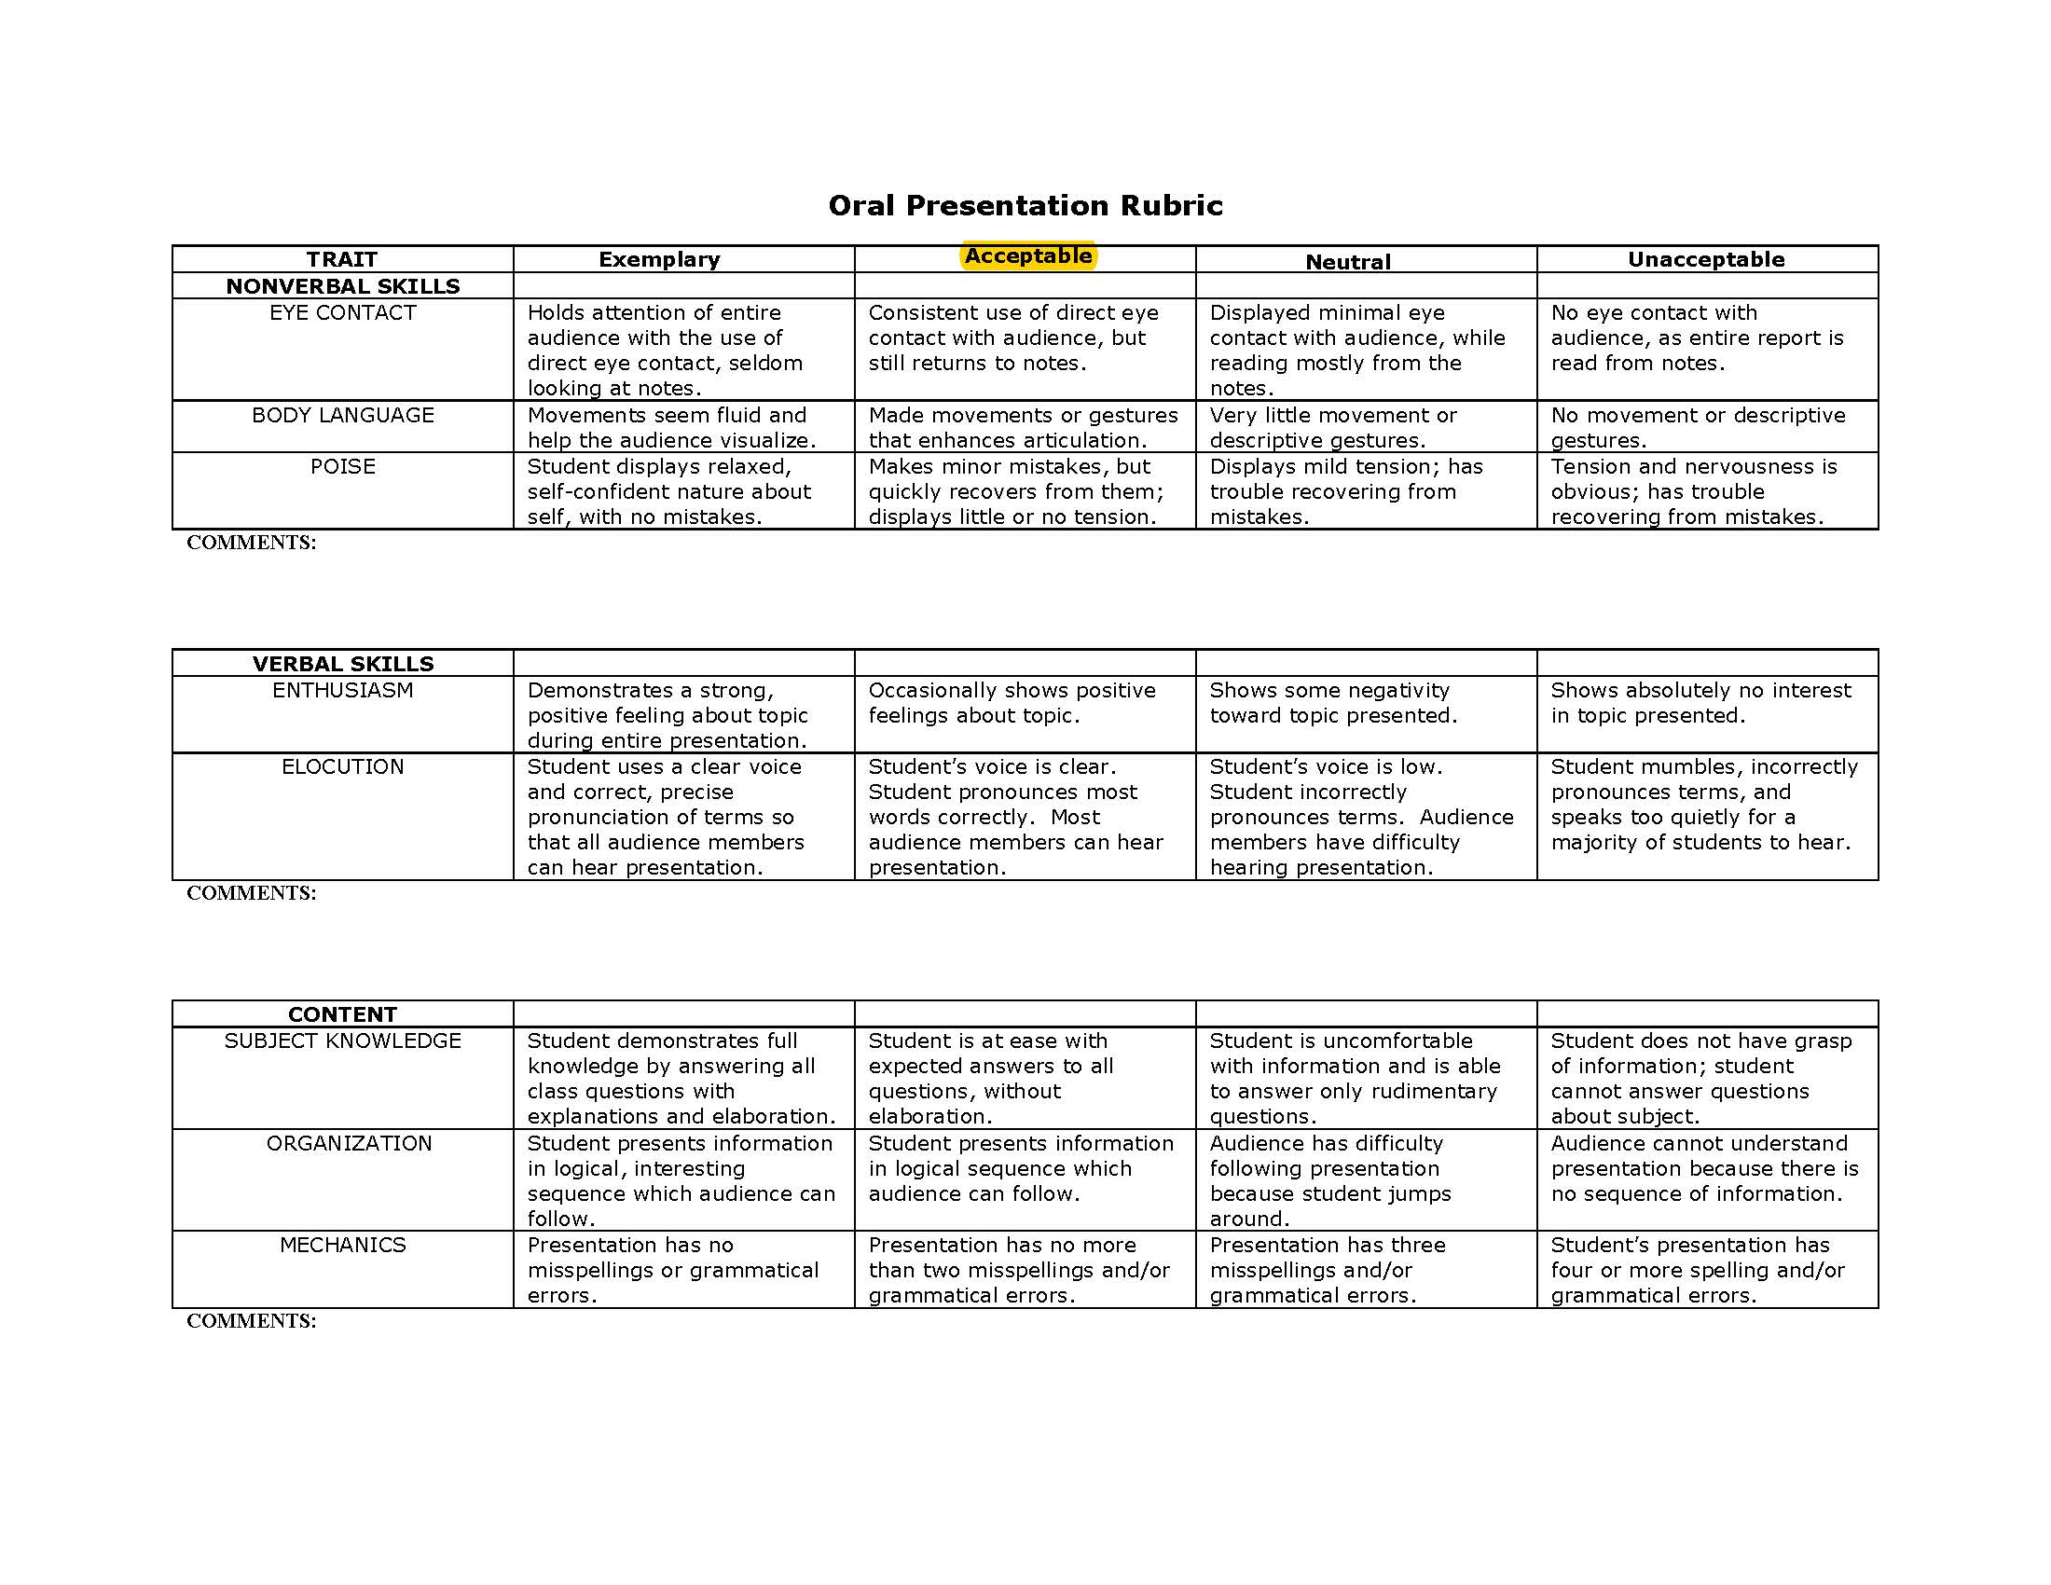
ELEMENTS
If using Itemized Analysis, it’s often knowledge. Usually those are multiple choice questions/answers.

Slide 4
Sticky Spots
What other things are you hearing that’s causing confusion?

Slide 5
Goal, Outcomes
Assessment Cycle
Design Action Plan “Closing the Loop”
Identify Measures, Method & Targets
Share, report and analyze data & findings
Collect Data

