Slide 1
WEAVE Reports
Findings, Summaries and Findings, Action Plans, and everything in between.
Spring 2022

Slide 2
WHO are these assessment reports for?
ANSWER: YOU, YOUR CURRICULUM COMMITTEES, YOUR FACULTY and YOUR DEANS
NOT BRIANNA, DAVID or SACSCOC!
Notes:
Record--use WEAVE as a record to help you recall what you have done in the past/others can pick up where you left offf.

Slide 3
What’s in our report?
Findings-brief statement about data collected (255 character max in WEAVE)
Summary/Analysis- in-depth analysis about what happened in the data and what could have contributed to the results stated above (5000 character max in WEAVE)
*you can do more but I can’t promise it will show up in the reports that weave generates
Action Plan-Steps you plan on taking to improve results based on assessment data collected and analyzed (no max in WEAVE)

Slide 4
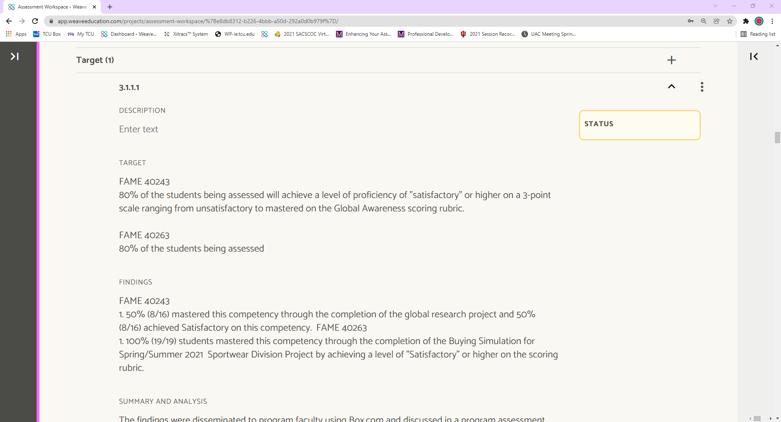
What’s in our report?
Findings-brief statement about data collected (255 character max in WEAVE)
Summary/Analysis- in-depth analysis about what happened in the data and what could have contributed to the results stated above (5000 character max in WEAVE)
Action Plan-Steps you plan on taking to improve results based on assessment data collected and analyzed (no max in WEAVE)

Slide 5
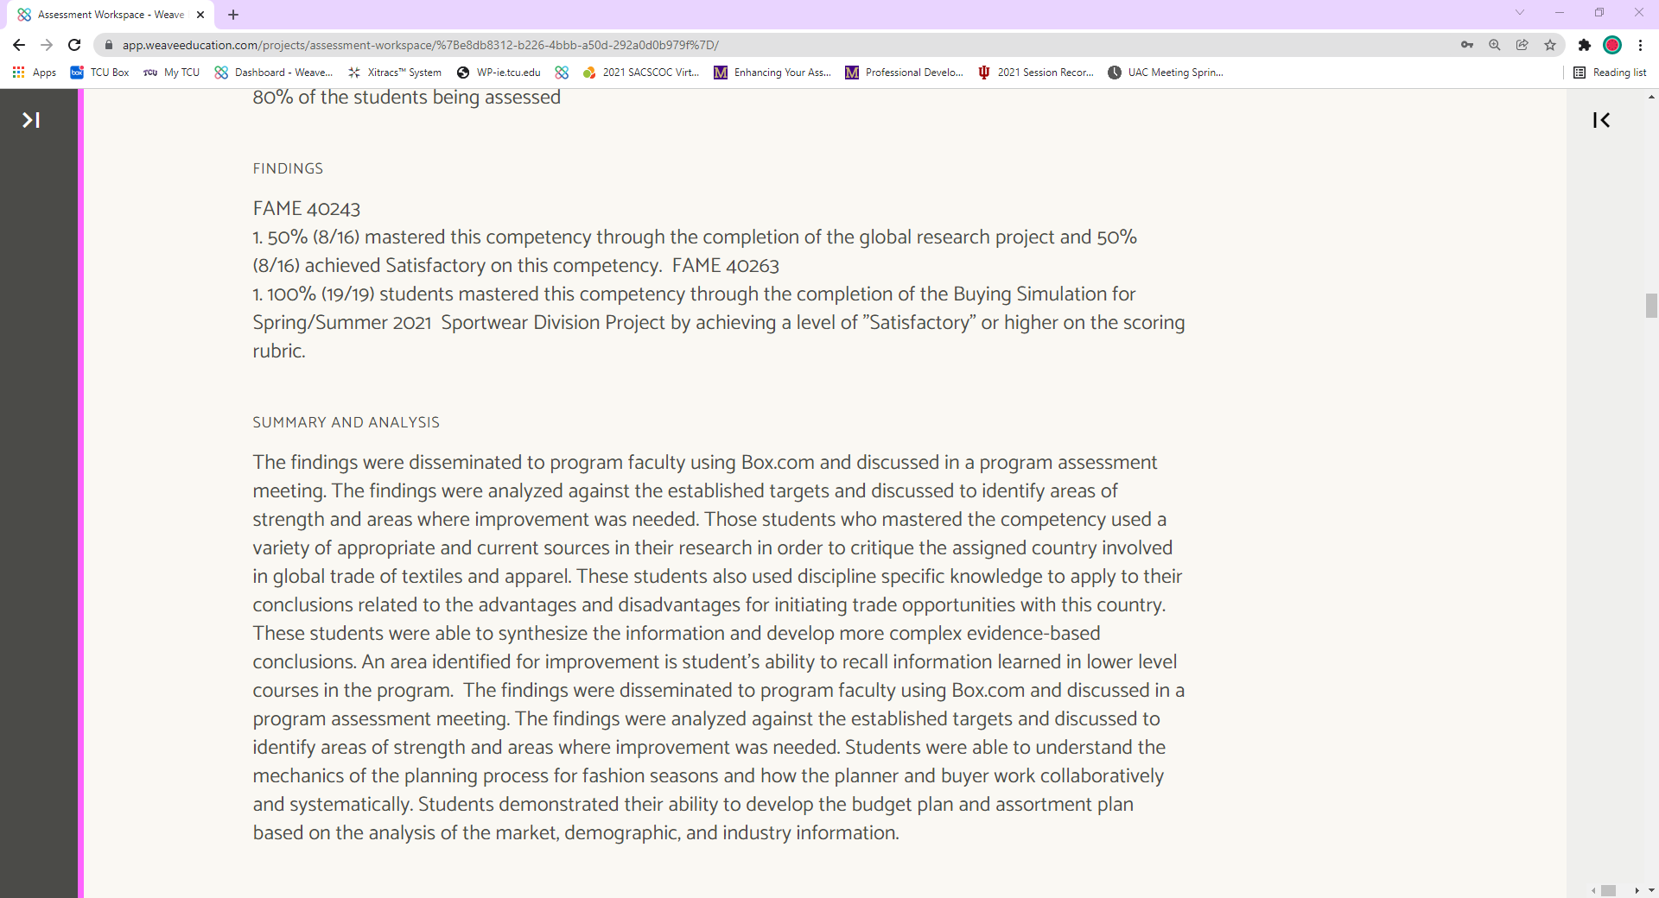
What’s in our report?
Findings-brief statement about data collected (255 character max in WEAVE)
Summary/Analysis- in-depth analysis about what happened in the data and what could have contributed to the results stated above (5000 character max in WEAVE)
Action Plan-Steps you plan on taking to improve results based on assessment data collected and analyzed (no max in WEAVE)

Slide 6
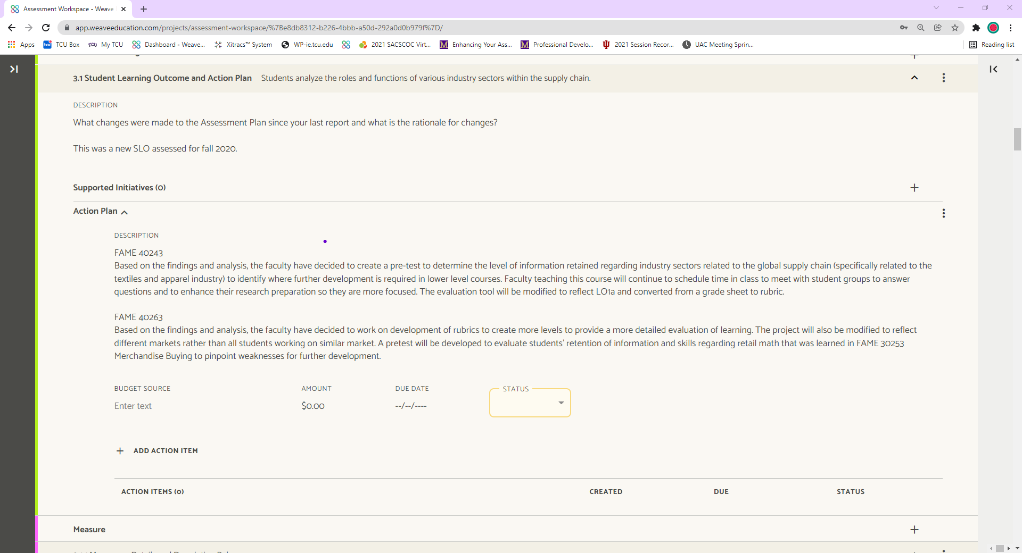
What’s in our report?
Findings-brief statement about data collected (255 character max in WEAVE)
Summary/Analysis- in-depth analysis about what happened in the data and what could have contributed to the results stated above (5000 character max in WEAVE)
Action Plan-Steps you plan on taking to improve results based on assessment data collected and analyzed (no max in WEAVE)

Slide 7
Report Rubric
 | Exemplary 3 | Acceptable 2 | Developing 1
Findings | • A complete, concise, and well-organized summary of the percentage of students and the Level of Proficiency achieved is provided. | • A complete and organized summary of the percentage of students and the Level of Proficiency achieved is provided. | • The Findings are incomplete OR do not clearly align with the Target.
Summary and Analysis | • Analysis of the Findings by program faculty includes solid evidence that the Target was met or not met. • Analysis of the Findings references supporting documentation. • Elaborates on specific findings used to make program improvements. • Makes a clear connection between finding(s) and action plan(s). • Provides thorough status update of previous and/or ongoing action plan(s) | • Analysis of the Findings by program faculty address whether the Target was met or not met • Identifies finding(s) used to make program improvements. • Changes/improvements made to program relate to finding(s). • Refers to previous and/or ongoing action plan(s). | • The Analysis of the Findings is not included OR the Analysis of the Findings is unclear about whether the Target was met or not met. • Failure to identify finding(s) used to make program improvements. • Does not refer to previous and/or ongoing action plan(s).
Action Plan | • Action plans clearly follow from assessment results and directly state which finding(s) was used to develop the plan • Identifies an area that needs to be monitored, remediated or enhanced and defines logical next steps • Plan is detailed and identifies completion dates & Person(s) responsible | • Reflects with sufficient depth on what was learned during the assessment cycle. • Actions plans follow from assessment results. | • No changes are provided OR changes provided lack thoughtful interpretation or “next steps” for program improvement.

Slide 8
HOW TO GET A 1 on findings
Incomplete Findings
Do Not Clearly Align w/ the Target
TARGET: 80% of students will receive a 7/10 on the reading rubric
FINDINGS: 12 students received a satisfactory score on the rubric.
*your findings should MIRROR your target statement*
There’s nothing there
Or partial sentence (Remember 255 character max. )

Slide 9
Report Rubric
 | Exemplary 3 | Acceptable 2 | Developing 1
Findings | • A complete, concise, and well-organized summary of the percentage of students and the Level of Proficiency achieved is provided. | • A complete and organized summary of the percentage of students and the Level of Proficiency achieved is provided. | • The Findings are incomplete OR do not clearly align with the Target.
Summary and Analysis | • Analysis of the Findings by program faculty includes solid evidence that the Target was met or not met. • Analysis of the Findings references supporting documentation. • Elaborates on specific findings used to make program improvements. • Makes a clear connection between finding(s) and action plan(s). • Provides thorough status update of previous and/or ongoing action plan(s) | • Analysis of the Findings by program faculty address whether the Target was met or not met • Identifies finding(s) used to make program improvements. • Changes/improvements made to program relate to finding(s). • Refers to previous and/or ongoing action plan(s). | • The Analysis of the Findings is not included OR the Analysis of the Findings is unclear about whether the Target was met or not met. • Failure to identify finding(s) used to make program improvements. • Does not refer to previous and/or ongoing action plan(s).
Action Plan | • Action plans clearly follow from assessment results and directly state which finding(s) was used to develop the plan • Identifies an area that needs to be monitored, remediated or enhanced and defines logical next steps • Plan is detailed and identifies completion dates & Person(s) responsible | • Reflects with sufficient depth on what was learned during the assessment cycle. • Actions plans follow from assessment results. | • No changes are provided OR changes provided lack thoughtful interpretation or “next steps” for program improvement.
,

Slide 10
*your findings should MIRROR your target statement*
Perfect.
2-only because this is a straight forward target. So there’s not much organization needed for the statement

Slide 11
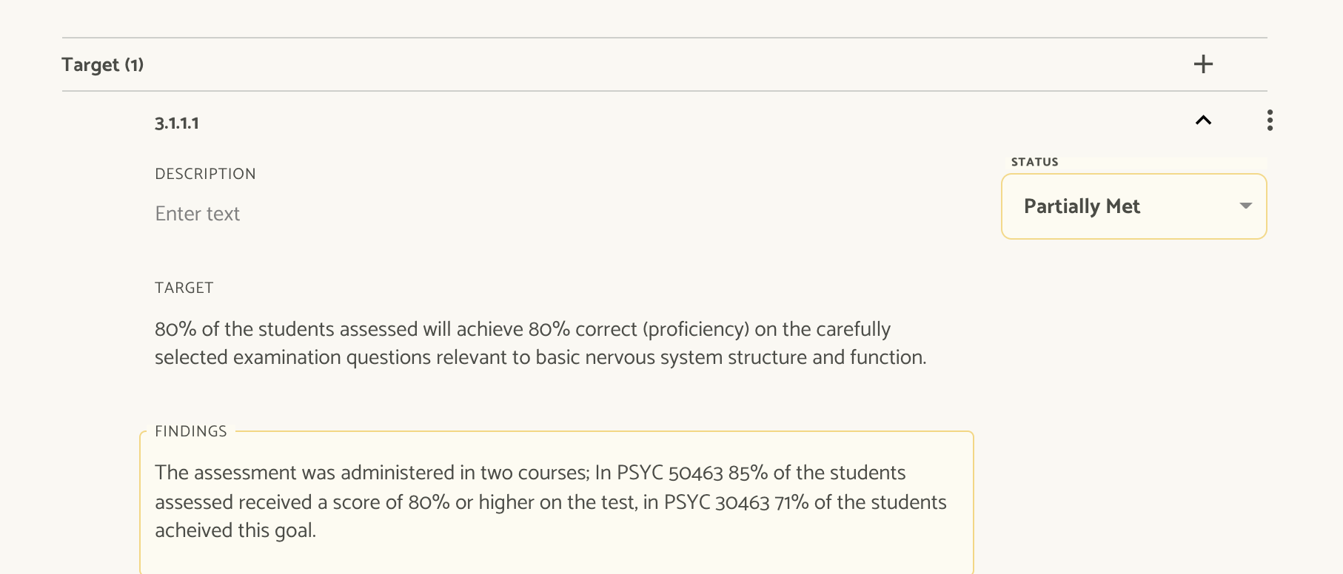

Slide 12
Summary and Analysis-in-depth analysis about what happened in the data and what could have contributed to the results stated above
How well did students learn what you wanted them to learn?
REMINDER: THIS IS FOR YOU
What worked well? What didn’t?
Were you able to implement all the changes in your pervious action plan? Was it effective or ineffective?
What specific components can you IMPORVE on?
5000 character max in WEAVE (that’s still a lot of writing.)

Slide 13
Report Rubric
 | Exemplary 3 | Acceptable 2 | Developing 1
Findings | • A complete, concise, and well-organized summary of the percentage of students and the Level of Proficiency achieved is provided. | • A complete and organized summary of the percentage of students and the Level of Proficiency achieved is provided. | • The Findings are incomplete OR do not clearly align with the Target.
Summary and Analysis | • Analysis of the Findings by program faculty includes solid evidence that the Target was met or not met. • Analysis of the Findings references supporting documentation. • Elaborates on specific findings used to make program improvements. • Makes a clear connection between finding(s) and action plan(s). • Provides thorough status update of previous and/or ongoing action plan(s) | • Analysis of the Findings by program faculty address whether the Target was met or not met • Identifies finding(s) used to make program improvements. • Changes/improvements made to program relate to finding(s). • Refers to previous and/or ongoing action plan(s). | • The Analysis of the Findings is not included OR the Analysis of the Findings is unclear about whether the Target was met or not met. • Failure to identify finding(s) used to make program improvements. • Does not refer to previous and/or ongoing action plan(s).
Action Plan | • Action plans clearly follow from assessment results and directly state which finding(s) was used to develop the plan • Identifies an area that needs to be monitored, remediated or enhanced and defines logical next steps • Plan is detailed and identifies completion dates & Person(s) responsible | • Reflects with sufficient depth on what was learned during the assessment cycle. • Actions plans follow from assessment results. | • No changes are provided OR changes provided lack thoughtful interpretation or “next steps” for program improvement.
,

Slide 14
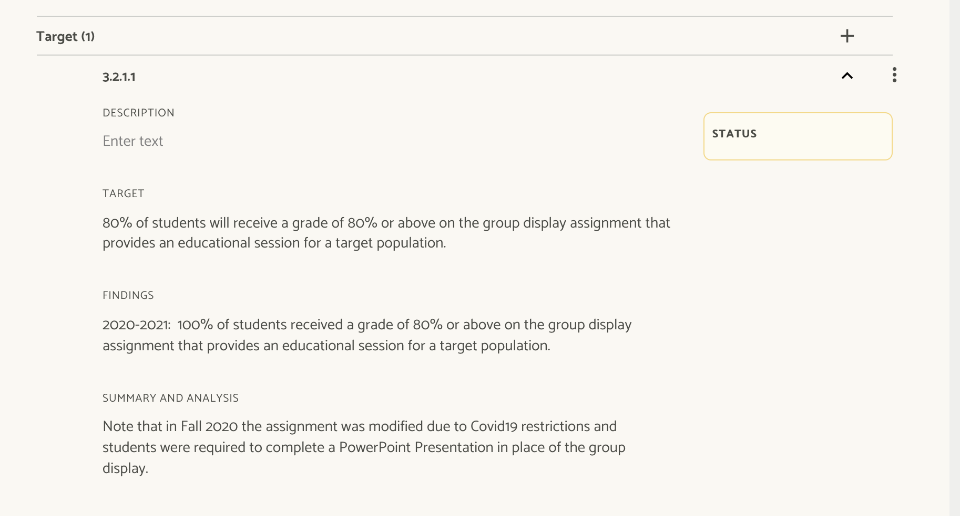

Slide 16
Report Rubric
 | Exemplary 3 | Acceptable 2 | Developing 1
Findings | • A complete, concise, and well-organized summary of the percentage of students and the Level of Proficiency achieved is provided. | • A complete and organized summary of the percentage of students and the Level of Proficiency achieved is provided. | • The Findings are incomplete OR do not clearly align with the Target.
Summary and Analysis | • Analysis of the Findings by program faculty includes solid evidence that the Target was met or not met. • Analysis of the Findings references supporting documentation. • Elaborates on specific findings used to make program improvements. • Makes a clear connection between finding(s) and action plan(s). • Provides thorough status update of previous and/or ongoing action plan(s) | • Analysis of the Findings by program faculty address whether the Target was met or not met • Identifies finding(s) used to make program improvements. • Changes/improvements made to program relate to finding(s). • Refers to previous and/or ongoing action plan(s). | • The Analysis of the Findings is not included OR the Analysis of the Findings is unclear about whether the Target was met or not met. • Failure to identify finding(s) used to make program improvements. • Does not refer to previous and/or ongoing action plan(s).
Action Plan | • Action plans clearly follow from assessment results and directly state which finding(s) was used to develop the plan • Identifies an area that needs to be monitored, remediated or enhanced and defines logical next steps • Plan is detailed and identifies completion dates & Person(s) responsible | • Reflects with sufficient depth on what was learned during the assessment cycle. • Actions plans follow from assessment results. | • No changes are provided OR changes provided lack thoughtful interpretation or “next steps” for program improvement.
,

Slide 17
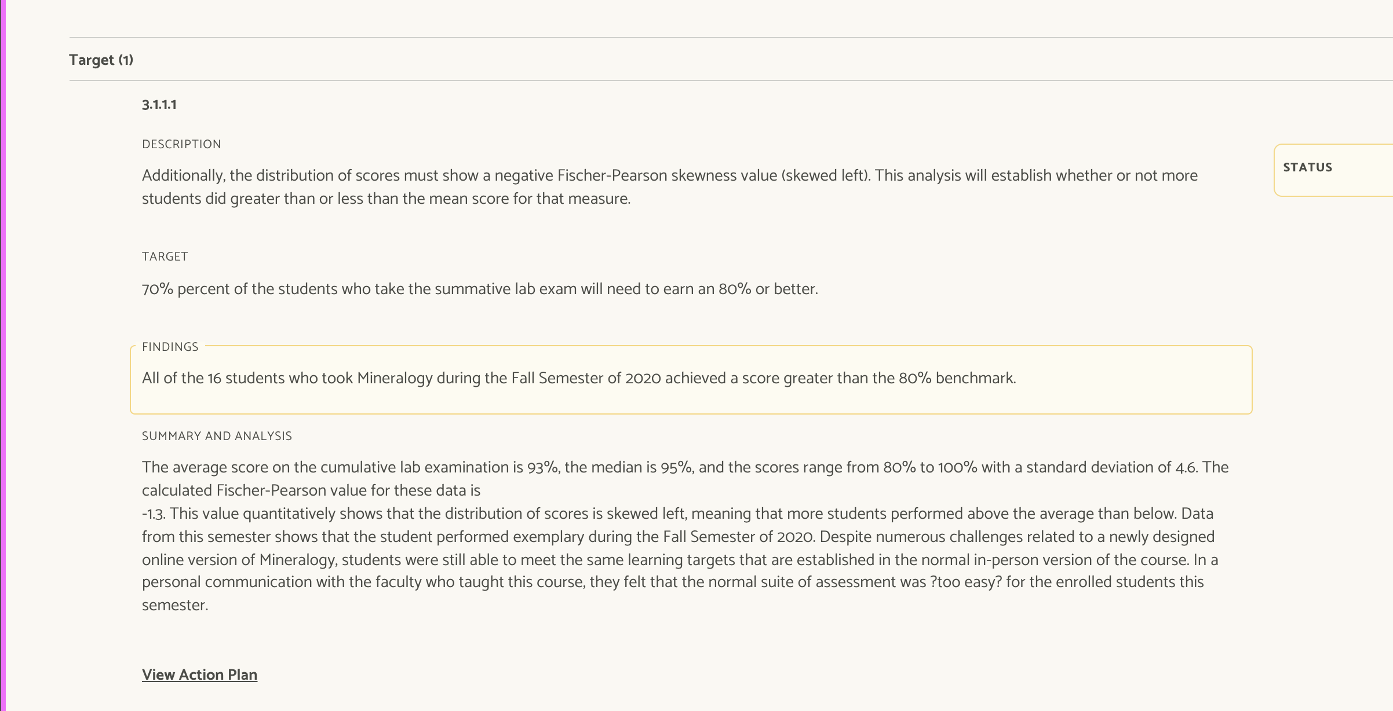

Slide 18
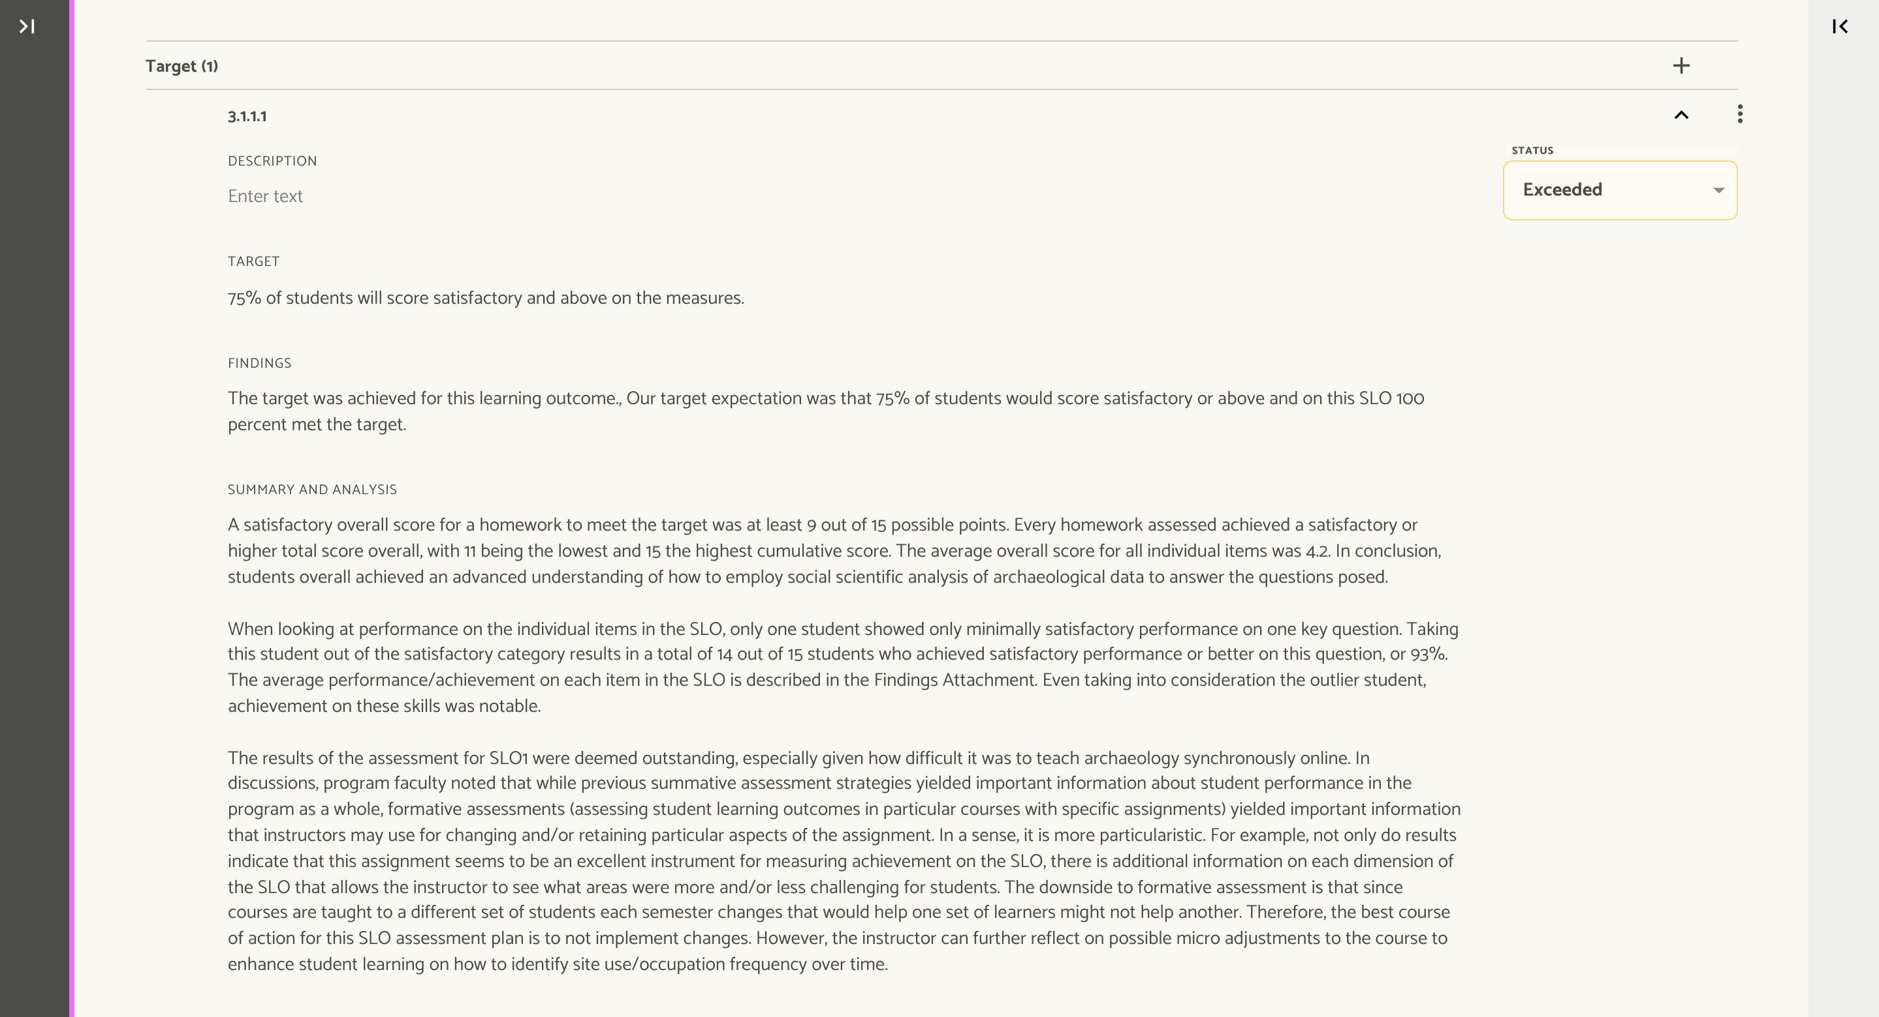

Slide 19
Action plans
“At its heart, assessment is fundamentally a tool to bring about better learning. If your college truly values great teaching and learning, and if you focus conversations not on assessment but helping students learn, you will engage those faculty and staff who are enthusiastic teachers…” – Linda Suskie, pg 178 Assessing Student Learning A Common Sense Guide 2003

Slide 20
ACTION PLANS
Steps you plan on taking to improve results based on assessment data collected and analyzed
We are looking for thoughtful answers and actionable steps to take
“we will meet with faculty to discuss”: will not work it is the product of that discussion that you talk about here.

Slide 21
Action plans-Steps you plan on taking to improve results based on assessment data collected and analyzed

Slide 22
Report Rubric
 | Exemplary 3 | Acceptable 2 | Developing 1
Findings | • A complete, concise, and well-organized summary of the percentage of students and the Level of Proficiency achieved is provided. | • A complete and organized summary of the percentage of students and the Level of Proficiency achieved is provided. | • The Findings are incomplete OR do not clearly align with the Target.
Summary and Analysis | • Analysis of the Findings by program faculty includes solid evidence that the Target was met or not met. • Analysis of the Findings references supporting documentation. • Elaborates on specific findings used to make program improvements. • Makes a clear connection between finding(s) and action plan(s). • Provides thorough status update of previous and/or ongoing action plan(s) | • Analysis of the Findings by program faculty address whether the Target was met or not met • Identifies finding(s) used to make program improvements. • Changes/improvements made to program relate to finding(s). • Refers to previous and/or ongoing action plan(s). | • The Analysis of the Findings is not included OR the Analysis of the Findings is unclear about whether the Target was met or not met. • Failure to identify finding(s) used to make program improvements. • Does not refer to previous and/or ongoing action plan(s).
Action Plan | • Action plans clearly follow from assessment results and directly state which finding(s) was used to develop the plan • Identifies an area that needs to be monitored, remediated or enhanced and defines logical next steps • Plan is detailed and identifies completion dates & Person(s) responsible | • Reflects with sufficient depth on what was learned during the assessment cycle. • Actions plans follow from assessment results. | • No changes are provided OR changes provided lack thoughtful interpretation or “next steps” for program improvement.
,

Slide 23
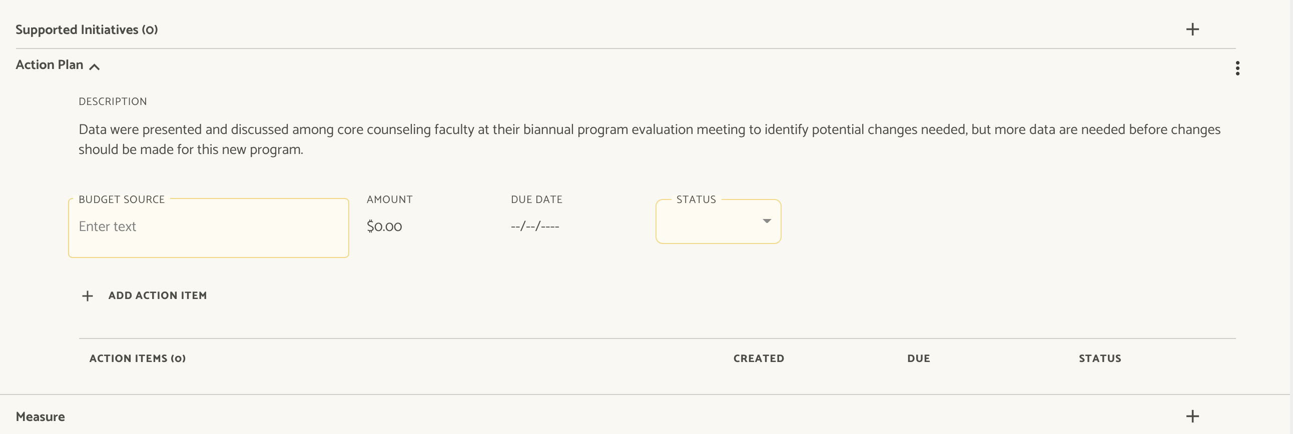

Slide 24
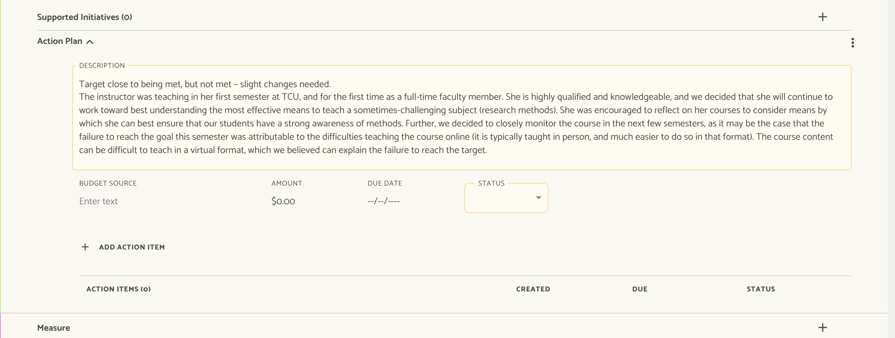

Slide 26
Final Reminders
24 Jan. 2022
Assessment Reports due
Complete Findings, Summary and Analysis, and Action Plans in WEAVE
25 Jan. – 11 Feb.
Assessment Ambassador Review
Assessment Ambassadors will need to consult with the program directors and help rectify any low scoring sections from the report rubric before moving on to UAC review.
14 Feb. – 4 Mar.
University Assessment Committee Review
UAC Members will review and submit feedback on assigned assessment reports.
4 Mar.
2022 Assessment Plans are Due in WEAVE

Slide 27
Questions?

